Slide 1
Micah Altman Massachusetts Institute of Technology
Eric Magar Instituto Tecnológico Autónomo de México
Michael McDonald University of Florida
Alejandro Trelles University of Pittsburgh
The Effects of Automated Redistricting and Partisan Strategic Interaction on Representation: The Case of Mexico

Slide 2
Mexico’s Redistricting Process
Federal Electoral Institute (IFE)* Appoints Technical Committee, Adopts Redistricting Criteria, Algorithm & Weights
Apportionment of 300
Legislative Single-Member Districts
to 32 States
Optimization Algorithm Produces First Scenario for Every State (32)
* in 2014, IFE became National Electoral Institute (INE)
Technical Committee Evaluates Partisan Counterproposals for each State
Second Scenario
is Created Based on Partisan Counterproposals
National & State Parties Propose Amendments, Must Improve Score
National & State Parties Propose a Second Round of Amendments, Must Improve Score
Technical Committee Evaluates Second Round of Partisan Counterproposals
Technical Committee Proposes
Third (Final) Scenario to IFE’s General Council

Slide 3
(Mal)apportionment
Seats awarded to states using Hamilton method of largest remainders.
Redistricting is based on censuses conducted in years ending in ‘0’, but redistricting can happen any time.
Since Mexico has 300 single-member districts, new plans have been drawn for the 1979, 1997, 2006, and 2015 elections.

Slide 4
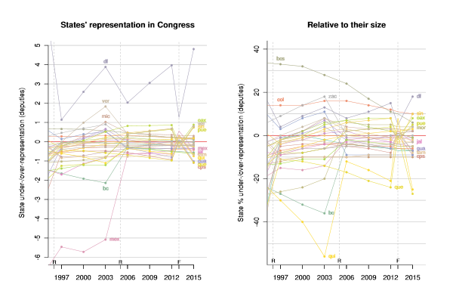
(Mal)apportionment

Slide 5
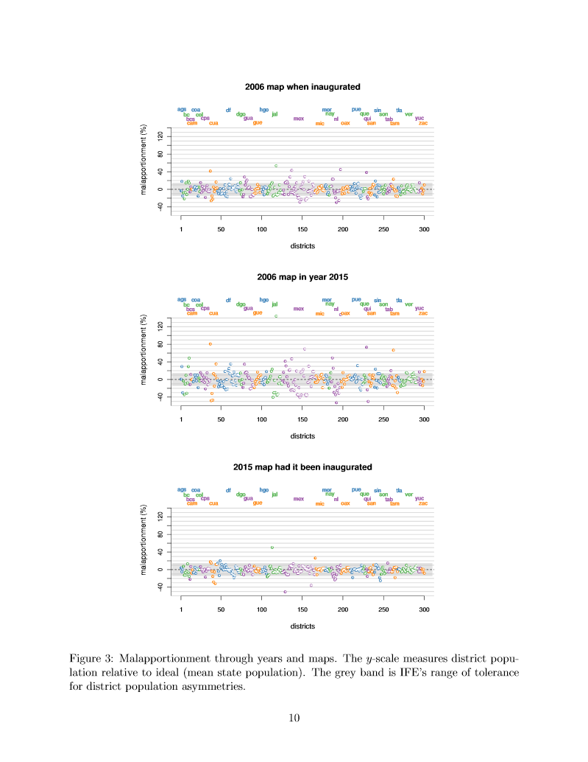
(Mal)apportionment
Unequal district population size due to use of out-of-date census
Grey band represents IFE’s allowed population tolerance, using most recent census, our figures project population to time of redistricting

Slide 6
(Mal)apportionment
Unequal district population size due to use of out-of-date census
Grey band represents IFE’s allowed population tolerance, using most recent census, our figures project population to time of redistricting

Slide 7
(Mal)apportionment
Unequal district population size due to use of out-of-date census
Grey band represents IFE’s allowed population tolerance, using most recent census, our figures project population to time of redistricting

Slide 8
Mexico’s Redistricting Process
Federal Electoral Institute (IFE)* Appoints Technical Committee, Adopts Redistricting Criteria, Algorithm & Weights
Apportionment of 300
Legislative Single-Member Districts
to 32 States
Optimization Algorithm Produces First Scenario for Every State (32)
* in 2014, IFE became National Electoral Institute (INE)
Technical Committee Evaluates Partisan Counterproposals for each State
Second Scenario
is Created Based on Partisan Counterproposals
National & State Parties Propose Amendments, Must Improve Score
National & State Parties Propose a Second Round of Amendments, Must Improve Score
Technical Committee Evaluates Second Round of Partisan Counterproposals
Technical Committee Proposes
Third (Final) Scenario to IFE’s General Council

Slide 9
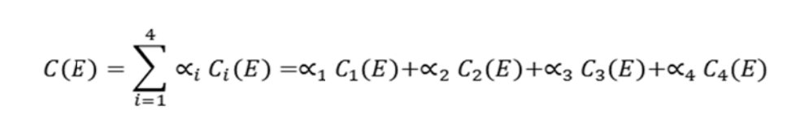
Optimization Cost Function*
C₁(E) = Population balance (up to +/- 15% tolerance). Weight: α₁ = 40%
C₂(E) = Preservation of municipality boundaries. Weight: α₂ = 30%
C₃(E) = Minimization of travel time. Weight: α₃ = 20%
C₄(E) = District Compactness. Weight: α₄ = 10%
Base geography (secciones) modified such that indigenous communities (municipios with at least 40% of indigenous population) cannot be split.
*Source: Federal Electoral Institute Agreement CG50/2013

Slide 10
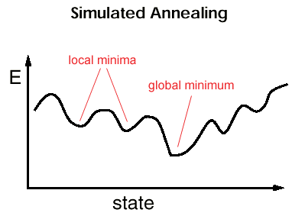
Optimization Algorithm
Simulated Annealing. Probabilistic meta-heuristic for the global optimization problem of locating a good approximation to the global optimum of a given function in a large search space.
The algorithm attempts to find the global minimum temperature of the
cost function through thousands of iterations (using secciones)
and restricted by the four parameters mentioned above.
This combinatorial optimization algorithm was used to generate
the first scenario in every one of the 32 states.

Slide 11
Implementation Transparency
Simulated Annealing is known to be sensitive to implementation
Key detail is convergence criteria -- Mexico process uses best-of-three, which is not best practice
Other details of Mexico’s implementation are almost entirely undocumented
Implementation is claimed to be open source, but is not actually publicly available
Initial results of plan and party responses are not made publicly available

Slide 12
Mexico’s Redistricting Process
Federal Electoral Institute (IFE)* Appoints Technical Committee, Adopts Redistricting Criteria, Algorithm & Weights
Apportionment of 300
Legislative Single-Member Districts
to 32 States
Optimization Algorithm Produces First Scenario for Every State (32)
* in 2014, IFE became National Electoral Institute (INE)
Technical Committee Evaluates Partisan Counterproposals for each State
Second Scenario
is Created Based on Partisan Counterproposals
National & State Parties Propose Amendments, Must Improve Score
National & State Parties Propose a Second Round of Amendments, Must Improve Score
Technical Committee Evaluates Second Round of Partisan Counterproposals
Technical Committee Proposes
Third (Final) Scenario to IFE’s General Council

Slide 13
Party Amendments
(Accepted)/(Proposed)
Party | National | State | Total 1st | National | State | Total 2nd | Total
PAN | 17/22 | 2/20 | 19/42 | 17/24 | 4/16 | 21/40 | 40/82
PRI | 0/0 | 2/28 | 2/28 | 8/30 | 6/26 | 14/56 | 16/84
PRD | 3/27 | 2/21 | 5/48 | 5/29 | 5/18 | 10/47 | 15/95
PT | 1/12 | 1/20 | 2/22 | 3/15 | 1/16 | 4/31 | 6/53
PVEM | 0/0 | 1/20 | 1/20 | 7/28 | 3/17 | 10/45 | 11/65
MC | 1/17 | 0/21 | 1/38 | 6/32 | 2/16 | 8/48 | 9/86
PNA | 0/1 | 1/18 | 1/19 | 4/11 | 3/17 | 7/28 | 8/47
IFE | 0/0 | 1/9 | 1/9 | 0/0 | 5/13 | 5/13 | 6/22
TOTAL | 22/79 | 10/157 | 32/226 | 50/169 | 29/139 | 43/308 | 111/534

Slide 14
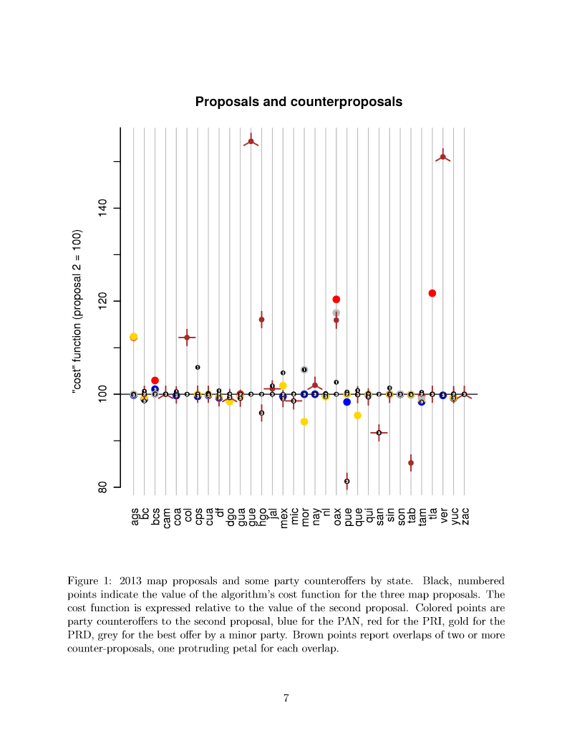
Party Amendments
cost scores relative to 2nd scenario
1st, 2nd &
3rd (final) Scenarios Black numbered circles
PAN Blue
PRI Red
PRD Gold
Minor Grey
Overlaps Brown, with a leaf for
each overlap

Slide 15
Party Amendments
Change to districts (% of new district population in old district)
Similarity Between | min | 25% | median | 75% | max
2006 plan & 1st 2015 scenario | 0.128 | 0.419 | 0.584 | 0.755 | 1
2006 plan & 3rd 2015 scenario | 0.125 | 0.437 | 0.643 | 0.805 | 1
1st 2015 scenario & 3rd 2015 scenario | 0.174 | 0.643 | 0.967 | 1 | 1

Slide 16
Party Amendments
Change to districts (% of new district population in old district)
Similarity Between | min | 25% | median | 75% | max
2006 plan & 1st 2015 scenario | 0.128 | 0.419 | 0.584 | 0.755 | 1
2006 plan & 3rd 2015 scenario | 0.125 | 0.437 | 0.643 | 0.805 | 1
1st 2015 scenario & 3rd 2015 scenario | 0.174 | 0.643 | 0.967 | 1 | 1
Changes to districts from 1st to 3rd (final) scenarios generally led to districts being more similar to existing districts

Slide 17
Party Amendments
Automation vs. Party Strategic Behavior
Humans can beat the computer(!), which enables manipulation.
Smoking gun: four plans (3 PRD and one PRI/PVEM) objectively improved score, but were not adopted.
Cannot know if other plans that improved score, but hurt parties, exist since they were not proposed.
Increased similarity of final plan to existing plan suggestive that only plans that favored status quo were proposed.
Not all parties had the same capacity to produce efficient counterproposals.
Parties are learning to interact strategically and more “rational” behavior is expected in subsequent rounds of redistricting at the national and local level (future research agenda).
PAN was, by far, the most effective in producing low cost counterproposals, but with marginal benefits for the party.

Slide 18
Bias and Responsiveness
Estimate across states
Average seats = 9.4, tends to increase estimate of responsiveness.
Bias estimates presented relative to PRI, positive number indicates bias in favor of party relative to PRI

Slide 19
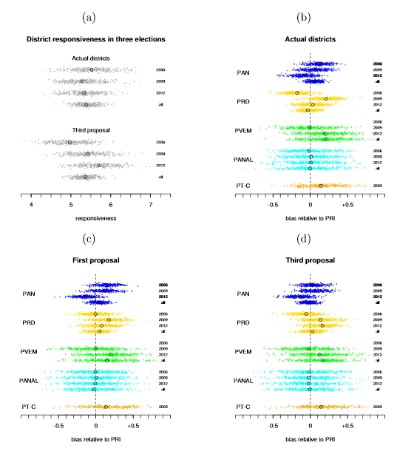
What Does It All Mean?

Slide 20
Bias and Responsiveness
For current districts
Bias favors PRD in 2006, but favors PRI in 2009
2015 redistricting
No bias for PAN and PRD,
Bias favoring PVEM and PT-C
Slight bias favoring PRD in 1st Scenario reduced in 3rd Scenario
Failed PRD amendments

Slide 21
Conclusions
Mexico’s use of automated optimal redistricting algorithm allows strategic party amendments by virtue of limitations of automated redistricting algorithms.
Strategic behavior is constrained. Any malapportionment or redistricting bias appears dominated by electoral conditions.
Observations: These results are not well-known since implementation and proposed plans are not public

